Slide 1

Security Scan for OpenStack
Demo 5
30 March 2018
Clara De Paolis
Dilip Makwana
Hao Wu
Chi Zhang

Slide 2

Project Overview (Recap)
Trilio provides support for VM backups on OpenStack
We are building a tool to scan these backups for vulnerabilities
We have built on an existing tool (vminspect) that uses libguestfs to read the backup images
We use instead the NVD CVE database and provide more details for each vulnerability
Our tool schedules running these scans on all VM images in a workload using Celery and RabbitMQ. Celery maintains the tasks in a queue, and assigns the tasks to idle workers sequentially.
Notes:
Hao

Slide 3
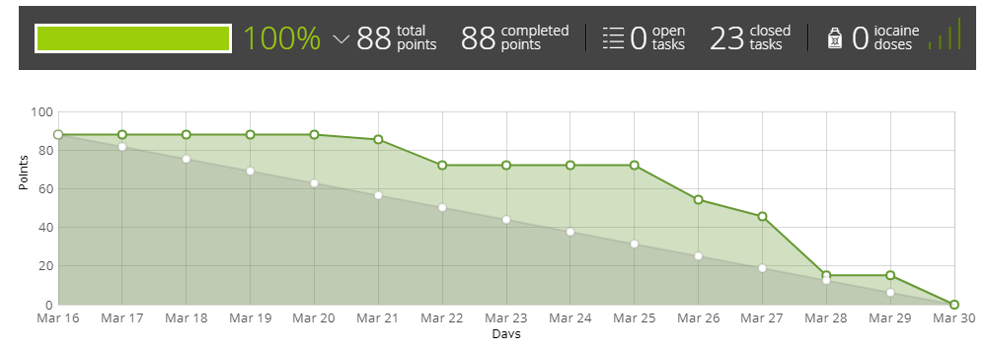
Progress Since Last Demo
Designed and specified new output schema of scans
Replaced the remote API for vulnscan with local database query
Set up the NFS drive so that all VMs can access the same repositories
Implemented the celery-based scaling solution across multiple VMs
Integration of end-to-end system, including
Discovering disk images in workload directory
Scheduling scans
Calling and running new scanning script
Saving results to workload
Notes:
Hao

Slide 4
Replace CVE API call
vulnscan
qcow image
find installed applications
API call to
http://cve.circl.lu
to get CVE id
original
vulnscan
find installed applications
API call to
http://cve.circl.lu
to get CVE id
qcow image
Sprint 4
download NVD CVE data feed
search CVE id in NVD CVE db to get full vuln. details
Notes:
Clara

Slide 5
Replace CVE API call
vulnscan
find installed applications
Search local db
to get CVE id and full vuln. details
Sprint 5
(current)
qcow image
download or update NVD CVE data feed
Notes:
Clara

Slide 6
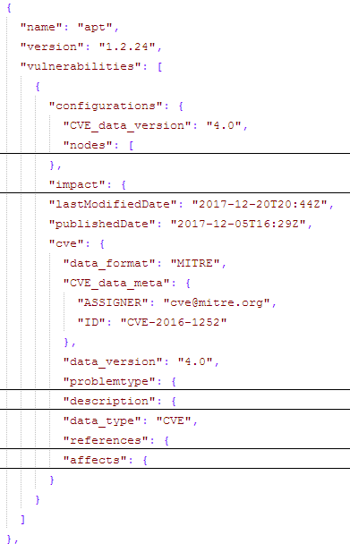
New output
Notes:
Clara

Slide 7
Storing the scans in shared NFS drive
After each scan, need to store result in self contained json file in shared NFS volume
Result file should be such that we can track down which vm produced this scan and the results of scan
This is possible using metadata along with results
This saved result file can be used to analyse various metrics as shown earlier in CVE output (threat levels, severity etc)
Resulting scan file = Metadata + scan results
Notes:
Dilip

Slide 8
Self identifying Metadata
Typical file path: /mnt/store/workload_52395c9b-e7a9-4e0c-a4a2-4578d105bff1/snapshot_1a04bb46-de77-4511-909f-2eacaf562592/vm_id_56e22431-d49c-41d3-8fa9-7846a9ea1e1b/vm_res_id_dc9a1d3f-3c68-492f-9da1-7ae161af648a_vda/195f6d48-fa65-4895-b48e-af203b82836c
workload_id : "52395c9b-e7a9-4e0c-a4a2-4578d105bff1"
snapshot_id : "1a04bb46-de77-4511-909f-2eacaf562592"
vm_id : "56e22431-d49c-41d3-8fa9-7846a9ea1e1b"
vm_res_id : "dc9a1d3f-3c68-492f-9da1-7ae161af648a_vda"
Notes:
Dilip

Slide 9
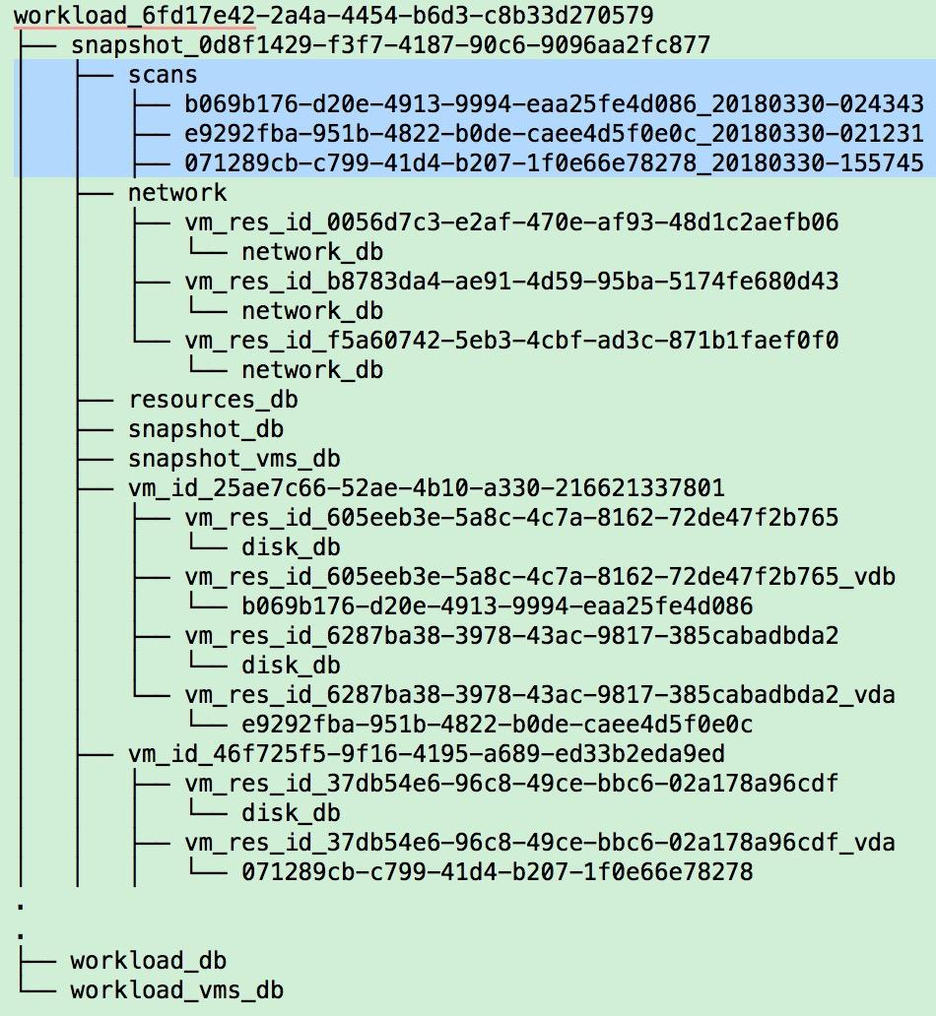
Notes:
Dilip

Slide 10
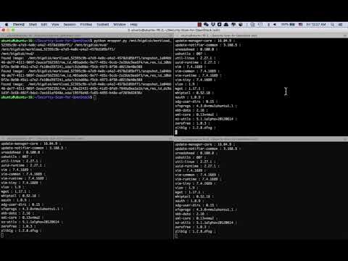
Scanning on Multiple VMs
Notes:
Chi

Slide 11
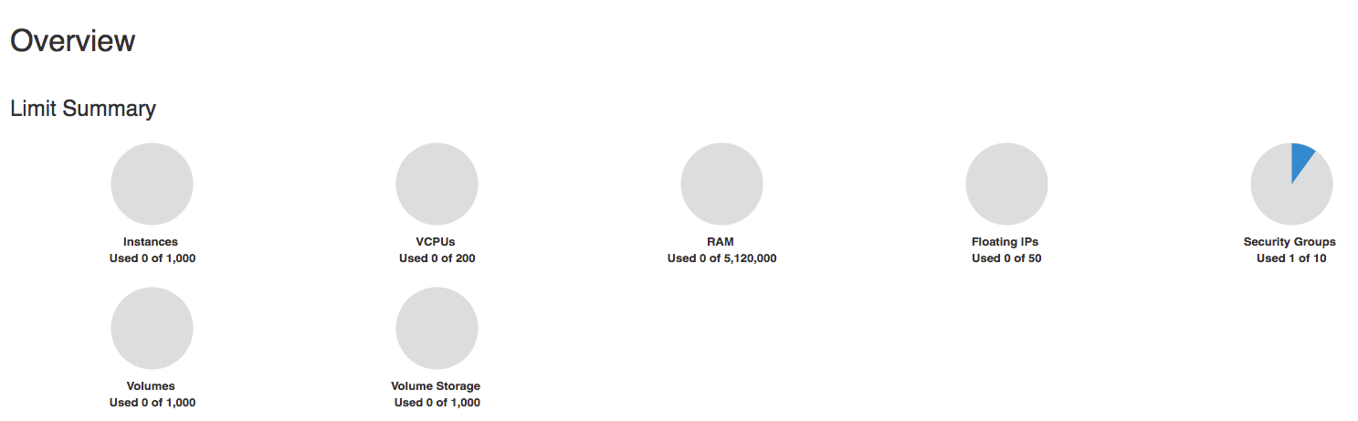
Progress in Integration
Trilio provided us with the access to their OpenStack
We can then upload any images and create workloads for testing
We can also use it for deployment in the next sprint
Notes:
Chi

Slide 12
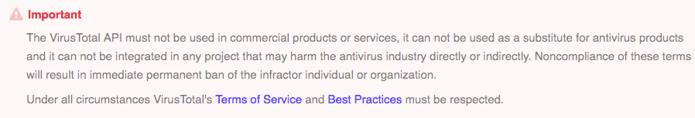
Virus Scan
Turned out the Virus Total can’t be used in commercial products
We found another similar service: https://onlinehelp.opswat.com/mdcloud/. But it also has the same restriction.
We have already synced the issue with Trilio. And they will decide to buy the private API key or not.
Notes:
Chi

Slide 13
Release Schedule
Sprint 6
Finishing up the end-to-end system. (Is not yet a simple one-click solution)
Demo our result to our mentor and work on feedback
Integrate with Trilio back-up tool
Deploy the solution into Trilio’s Openstack environment
Write a script to set up a client VM by one-click
Visualizing results. Turning json into an html page
Sprint 7
Testing of deployment
Testing end-to-end system with more diverse images
Polishing our outputs for the end user
Notes:
Hao

Slide 14
Integrating end-to-end System (old)
Read from Trilio’s workload
Read the backup images info from their json file
Using files metadata from Trilio as part of our outputs
Walk through the file structure
Spawn scanning task to Celery when found a qcow2 image
Save each scanning result (json file) to its corresponding image folder
Notes:
Hao

Slide 15
Sprint 5 Goals (old)
Replace the remote API for vulnscan with local database query
Store the JSON results in a shared storage space (inside snapshot__xyz folder of shared NFS volume)
Implement the chosen scaling solution (Celery-based multi-processing on multiple VMs)
For virus scan, use cache to solve the lower efficiency problem caused by API throttling (4 queries/min)

